Slide 1
Stage 15: The Big Event

Slide 2
Objectives
Repeat commands given by an instructor
Recognize actions of the teacher as signals to initiate commands
Practice differentiating pre-defined actions and event-driven ones

Slide 3
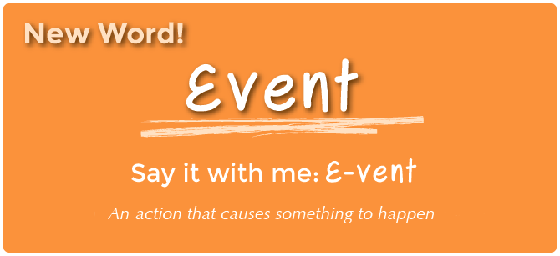
Vocabulary

Slide 4
Example of Event
I’m going to ask you a question. I want you to raise your hand if you want to answer.
How many thumbs do I have?
What is bigger, a bird or a horse?
How did you let me know that you wanted to be called on?
By raising your hand
When the student raised their hand, it is an “event” that causes you to know they want to be called on.

Slide 5
Event Examples
Can you think of any other events that give signals?
An alarm clock going off
Pressing start on the microwave
Pressing the power button on the TV remote
We are going to practice changing programs by introducing events.

Slide 6
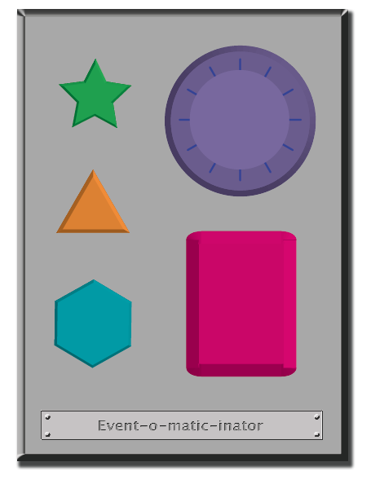
CLAP
?
STOMP
Say: “Yes”
Say “No”

Slide 7
Every time I push a button it is an event.

